Slide 1
Burke Presbyterian and the Honor Foundation Supporting Ukrainian grass-root defense work (personal information redacted for online publication)

Slide 2
Quick Summary
Ukraine has been fighting back a full-scale Russian attack since 2022.
Critical supplies remain scarce and bureaucracy is slow.
Grass-roots efforts bridge the gaps left by large organizations.
The Honor Foundation, based in Odessa, has been delivering supplies to civilians and front lines since 2022.
Burke Presbyterian has been supporting the Honor foundation’s work since 2023, building on [a member’s] support since 2022.
Father’s day collections → medical supplies → Honor Foundation → front lines
2023: collected $11,120 → ultrasound equipment
2024: collected $5,280 + $5,000 from Anton → tourniquets NCP Global Mission grant $3,000 → EKG machines and foot warmers
2025: $14,000 pre-pledged, full collection starts Sunday, submitting NCPGM application

Slide 3
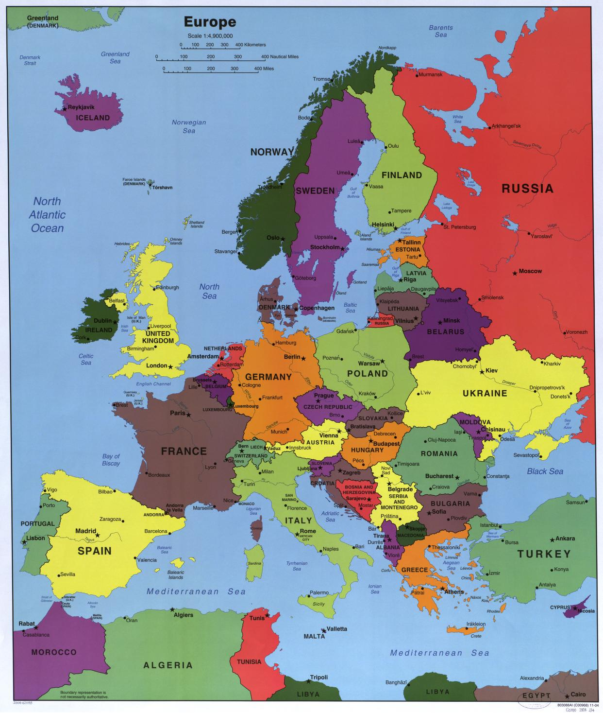
Ukraine
Second biggest country in Europe, after Russia, 41 million people.
Part of USSR until it dissolved in 1991, but Russia continued to assert control of Ukraine.
In 2014, Ukraine decided to break ties with Russia, planning to join the EU and NATO.
Russia took Crimea and parts of Eastern Ukraine.
In 2022, Russia began a full-scale attack, initially focused on deposing the government.
Ukraine fought back with foreign aid, civilian recruits, and grass-roots supplies.
8 million left the country, 8 million displaced, 80,000+ military dead, 400,000+ injured, 13,000+ civilians dead, 31,000+ injured

Slide 4
Honor Foundation
One of many grass-roots organizations supporting the defense effort through volunteer work and international donations.
Primary contact: [removed].
Primary goal: “providing direct, honest, and timely aid to those who are at the epicenter of the tragedy: on the front, under occupation, in evacuation, in trouble.”
Weekly deliveries of goods:
6,000 miles driven per month
Military: vehicles, equipment, medical supplies, cold-weather supplies
Civilians: aid to evacuees, elderly, and families in need
Children: presents, rehabilitation aids, basic aid
Animals: feed, transportation, support of shelters
Total budget: $650,000 since 2022.

Slide 5
Honor Foundation budget since 2023 (sorry, in Russian)
2023 год
Помощь военным: - 94 турникета CAT Gen 7 - 150 спасательных жилетов (проект «Вода = Жизнь») - 10 000 пар химических грелок (зимняя поддержка) - 25 автомобилей (из них 5 грузовых) 💰 Сумма: $72,989
Гуманитарная помощь: - 76 055 консервов - 4 773 упаковки круп - 13 593 единицы гигиенических и медицинских средств - 593 мешка корма для животных 💰 Сумма: $24,054
2024 год
Год расширения, регулярных миссий и сложной логистики
Помощь военным: - 34 легковых авто повышенной проходимости - 21 грузовик (12 специализированных) - Турникеты, медикаменты, маскировочные сети - Палатки, водонагреватели, тёплое оборудование 💰 Сумма: $392,752
Гуманитарная помощь: - 224 энергетических устройства (генераторы, повербанки) - 20 медицинских аппаратов - 193 единицы медицинской мебели и инвентаря - 165 матрасов и подушек - 290 комплектов санитарно-гигиенических средств - 1 800 пар носков - 300 кг корма для животных - Дополнительно — сладости и еда для моральной поддержки 💰 Сумма: $44,891
Логистика: - 44 выезда к военным за год - В среднем 10 000 км в месяц
2025 год (по состоянию на 1 июня)
Помощь военным: - 21 легковой автомобиль - 3 грузовика 💰 Сумма: $102,585
Гуманитарная помощь: - 10 000 пар химических грелок - 400 кг корма для животных - 130 единиц медицинского инвентаря - 128 единиц оборудования для офисов и мастерских 💰 Сумма: $17,359

Slide 6
Collection and Distribution
Needs are identified by the Honor Foundation in consultation with front line medics.
Funding is collected via yearly Fathers’ Day offerings and NCP grants.
Supplies are purchased and shipped to the Meest Express warehouse in NJ.
Meest Express delivers to the Honor Foundation in Odessa, Ukraine.
The Honor Foundation delivers to the front-line medics.
Photo of Burke Presbyterian Pastor with box of ultrasound equipment
Photo of Honor Foundation representative receiving the shipment
Photo of front-line medic with the ultrasound device

Slide 7
Work so far: 2023
Burke Presbyterian Church was looking for a way to aid Ukraine.
[BPC Member] had been working with the Honor foundation since 2022.
The Fathers Day offering gathered $11,120, used to purchase three Sonoque C5PL ultrasound devices, and donations of clothes, toiletries, and similar items.
Items were shipped by sea via Meest Express to Odessa, Ukraine, and distributed by the Honor Foundation.
Photo of donations, including the ultrasound equipment, clothes, and toiletries

Slide 8
Work so far: 2024
The Fathers Day offering gathered $10,280, $5,280 from BPC members, $5,000 from [BPC Member].
Purchased 27 junctional tourniquets (pictured) and 27 pelvic slings.
Flown by Meest Express to Odessa, distributed by the Honor Foundation.
The NCP Global Mission grant provided $3,000, matched by [BPC Member].
Purchased two portable EKG machines (ECG90A, $600) and 5400 pairs of footwarmers (Thermopad, $5,551, 948lbs) directly in Europe.
Transported from Berlin to Odessa and destinations by the Honor Foundation.
Photo of van with two pallets of footwarmers

Slide 9
Human Impact
It’s hard to quantify impact, but we are:
Saving lives.
Improving conditions on the front line.
Supporting morale among soldiers, civilians and those in support roles.
Fighting against authoritarianism and unprovoked aggression.
Supporting a positive image of the US and the Presbyterian Church.
Photo of soldiers outside, snow, footwarmers.
Photo of hospital nurses receiving ultrasound equipment
Photo at Burke Presbyterian: visitor from Honor Foundation posing with Ukrainian flag and members of the church.

Slide 10
Work now: 2025
The situation in Ukraine remains critical:
Heavy losses and war weariness on the front lines.
Continued attacks on civilian areas and infrastructure (power, water).
Many civilian areas fully destroyed.
The Honor Foundation notes the following top needs, in all quantities:
Medical supplies: junctional tourniquets, tourniquets, chest seals, etc.
Basic needs: water filters, insect repellent.
Burke Presbyterian Church has earmarked $2,000 towards Ukraine.
[BPC Member] will provide $12,000 towards the collection.
Fathers Day collection starts tomorrow, aiming for a further $10,000.
We will apply for an NCP Global Mission Matching Grant for $5,000.
Supplies will be selected in July based on updated need and budget, and quickly purchased and shipped through existing channels.

